Slide 1





THE CLIFFSNOTES VERSION
What we can expect if we buy Deck Commerce
DRIVING ORDER MANAGEMENT FOR TOP BRANDS
Notes:
Link to sales deck (awaiting access): https://docs.google.com/presentation/d/1c7jZdTgGnT6PKfvRs8MTmChwwNdvc61F/edit?usp=drive_link&ouid=106067513330118267478&rtpof=true&sd=true

Slide 2
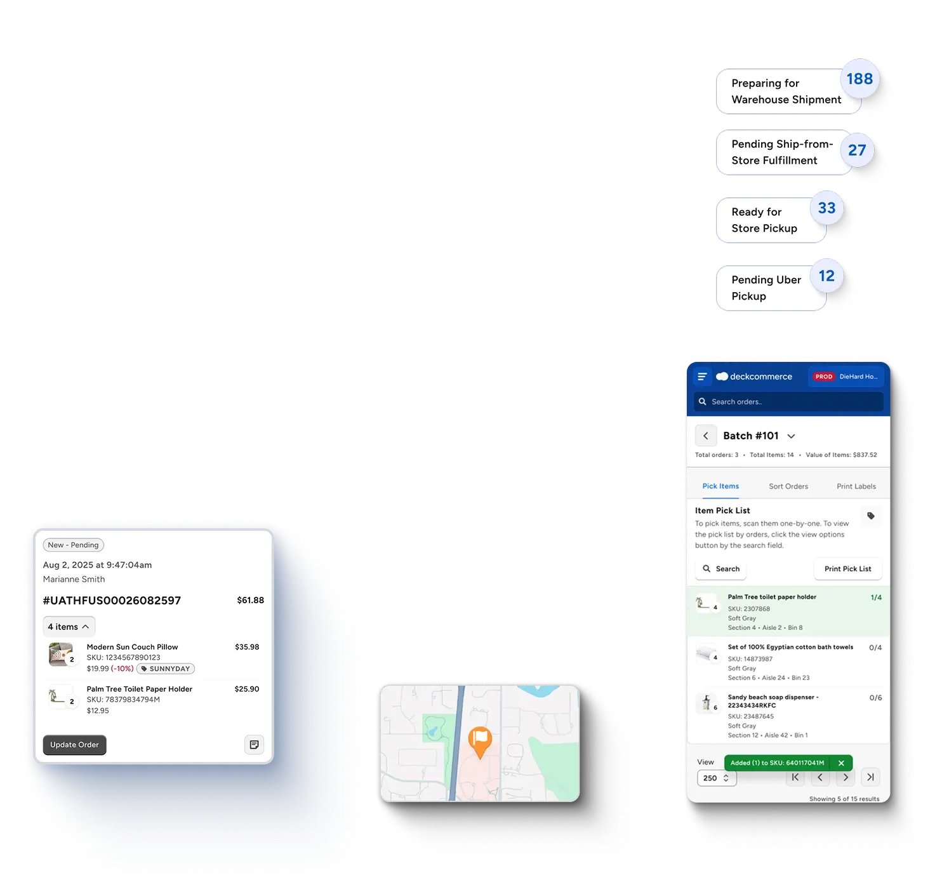
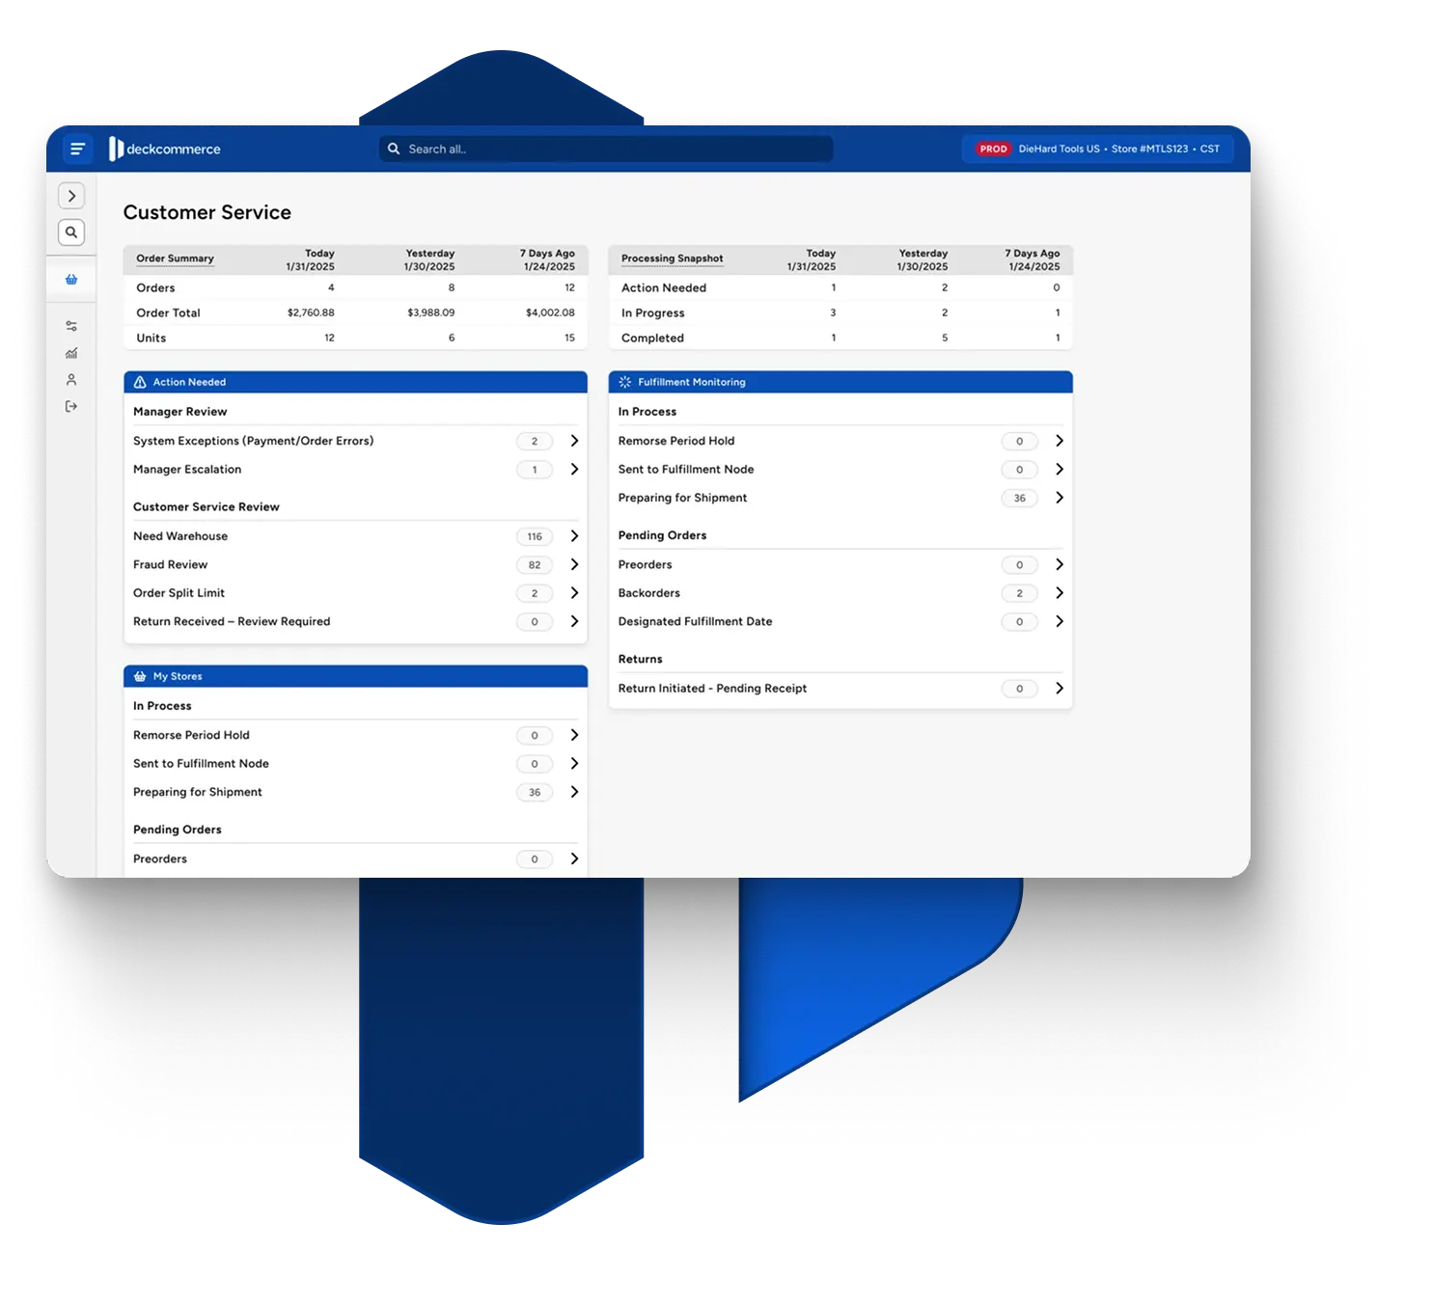
Deck Commerce would be a new way to manage inventory and orders across every channel.
WHAT WE COULD DO, BUT CAN’T DO TODAY:
1
Sync inventory in real time across channels
2
Auto-route orders → no spreadsheets needed
3
Connect data and processes across our commerce ecosystem
4
Launch new channels and fulfillment options fast

Slide 3


Anticipated timeline
2-3 MONTHS, IF WE WERE A TYPICAL CUSTOMER:
WHAT'S INVOLVED
Kick off & Environment Setup
We get you access and configure your environment.
Integrating ecommerce, ERP, and fulfillment systems
You begin your testing process.
Configuring order routing and fulfillment logic
UAT
Validate inventory syncs and data accuracy
Production
Promotion to production environments and go live.
Training and preparing teams for go-live
*Timelines can vary depending on client testing processes and project dependencies outside of OMS, such as system migrations occurring in parallel.

Slide 4


Amplified impact
Grow at your pace → start with core, and add modules (ex: in-store fulfillment) as you scale.
⏱️
Make inventory more available → stop oversells, surface hidden stock, unify across channels.
✔️
Free operations teams from repetitive work and automate 90%+ of order steps.
⚙️
Slash fulfillment costs via optimized routing and smarter location decisions.
💰
Learn more and see case studies

Slide 5
Paste a screenshot or export of your ROI Calculator here.
Return on investment

